Slide 1
NAME :- Henil Vinodbhai Prajapati Seat NO :- 1427 Guide :- Neha Mam
R.K. DESAI ACHCHHARIWALA COLLEGE OF COMPUTER & APPLIED SCIENCES, VAPI

Slide 2
INDEX
Sr No | Topics | Slide No.
1 | Project Title | 3
2 | Introduction , Site Purpose | 4 - 5
3 | Development Use | 6
4 | Objective | 7
5 | Flow Chart | 8
6 | Data Flow Diagram | 9 - 11
7 | ER Diagram | 12
8 | Project Limits | 13
10 | References | 14
11 | Live Preview | 15
12 | Thank You | 16

Slide 3

Web Chat
Online Gossip and Chatting Site

Slide 4
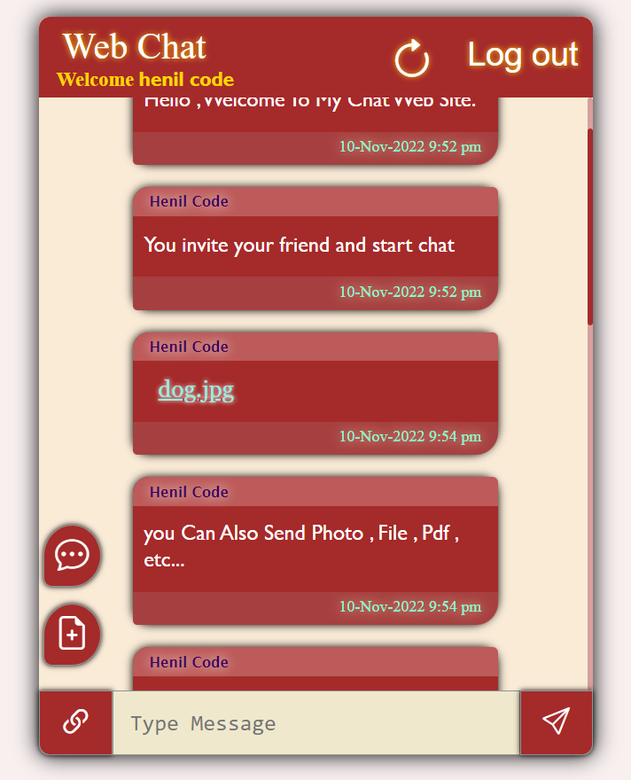
INTRODUCTION
Web chat is a free online chat website that allows users to connect with others.
That web site in many user can chat at a time and they can upload file.

Slide 5
DEVELOPMENT USE
Front-end : HTML , CSS , JavaScript
Back-end : PHP , MYSQL
Editor : Visual Studio Code
Icons : Bootstrap
Software : Xampp

Slide 6
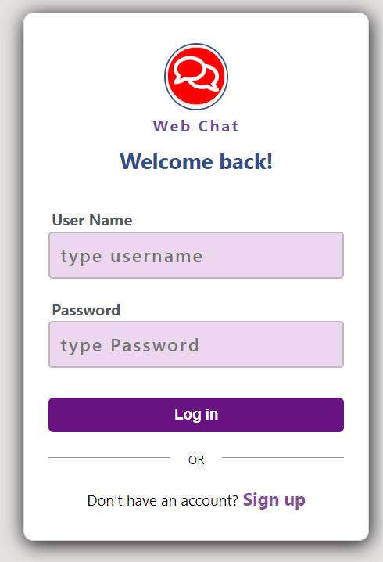
SITE PURPOSE
That web site purpose is a user can chat freely and upload photos without any charge and verification.
That website no any limit for chatting and file uploading.
That site main scope is user can start chatting with simple login opreation.

Slide 7
OBJECTIVE
You Can Use My Web Site to Any Browser.
That Site is Free of Cost and Unlimited Chatting.
User Can upload photos, videos.
You Can any place to access Web Chat Site.
You Can use my website Without any Verification.

Slide 8
Flow Chart
Start
User Input
Username and Password
Check if Valid user
False
NOT VALID
True
VALID
Start
Chatting

Slide 9
Data Flow Diagram
Zero Level / Context Level
Sender
Receiver
Web Chat
System Give response
System Give response
User Request to System
User Request to System

Slide 10
1st Level of DFD
Login Success
1.0
Log in
Login Success
Send Name and Password
Send Name and Password
Sender
Receiver
2.0
Chat
Response server
Response server
User Send Message
User Send Message
Response server
3.0
Image
Response server
User Send Image
User Send Image
4.0
Logout
Log out Success
Log out Success
Send Log Out Request
Send Log Out Request

Slide 11
2nd Level of DFD for 1.0 ( Log in )
Response Server
1.1
Check
Response Server
Send Name and Password
Send Name and Password
Sender
Receiver
1.2
Sign Up
Response server
Response server
Send Name , Email , Password
Send Name , Email , Password

Slide 12
ER DIAGRAM
User Name
Password
Email
Password
log in
Email
has
has
Name
Name
after
Password
sender
receiver
chat
Sender Name
Send Time
User Chat

Slide 13
Project Limits
In Feature User Can Chat Private With One to One User.
User Can See Photo Preview in chat box off Senedd Photo.
User Can See how many user are active in currently.
Build More User Friendly.

Slide 14
REFERENCE
YouTube
Google
Stack overflow

Slide 15

Live Preview
Type URL in Browser
Scan Web Site QR code
https://henil.rf.gd/

Slide 16


